Slide 1
EC544 Team 1 – Challenge 4 Steering
Abdulaziz Alhassan
Damini Ashok Chopra
Konstantino Sparakis,
Wenyng Zhang

Slide 2
Design Decision 1 – Wall Following
Controller Side:
Switch 1 for following LEFT wall.
Switch 2 for following RIGHT wall.
ON – Press and Hold.
OFF – Release (as the panic button).
Car Side
Two side sensors for detecting distances to the wall.
Store past values for decision making
Detect and normalize false readings from sensor
Detect Gaps in wall and keep driving straight with slight adjustments to opposite direction.

Slide 3
Design Decision 2 – Wall Avoiding
Controller Side:
Switch 1 for Automatic Mode.
Switch 2 Remote Control (Tilting) Mode.
ON – Press and Hold.
OFF – Release (as the panic button).
Car Side
Four sensors on Left Front, Left Back, Right Front, Right Back
Do decision making based on the cases.

Slide 4
Technologies
IR Sensors
SunSPOTs
NO Ultrasonic Sensor – Inconsistent output readings
NO Compass – Unreliable indoor

Slide 5
Challenges
Unreliable readings/ glitches from the sensors
Avoiding holes especially the big holes at the center of the hallway.

Slide 6
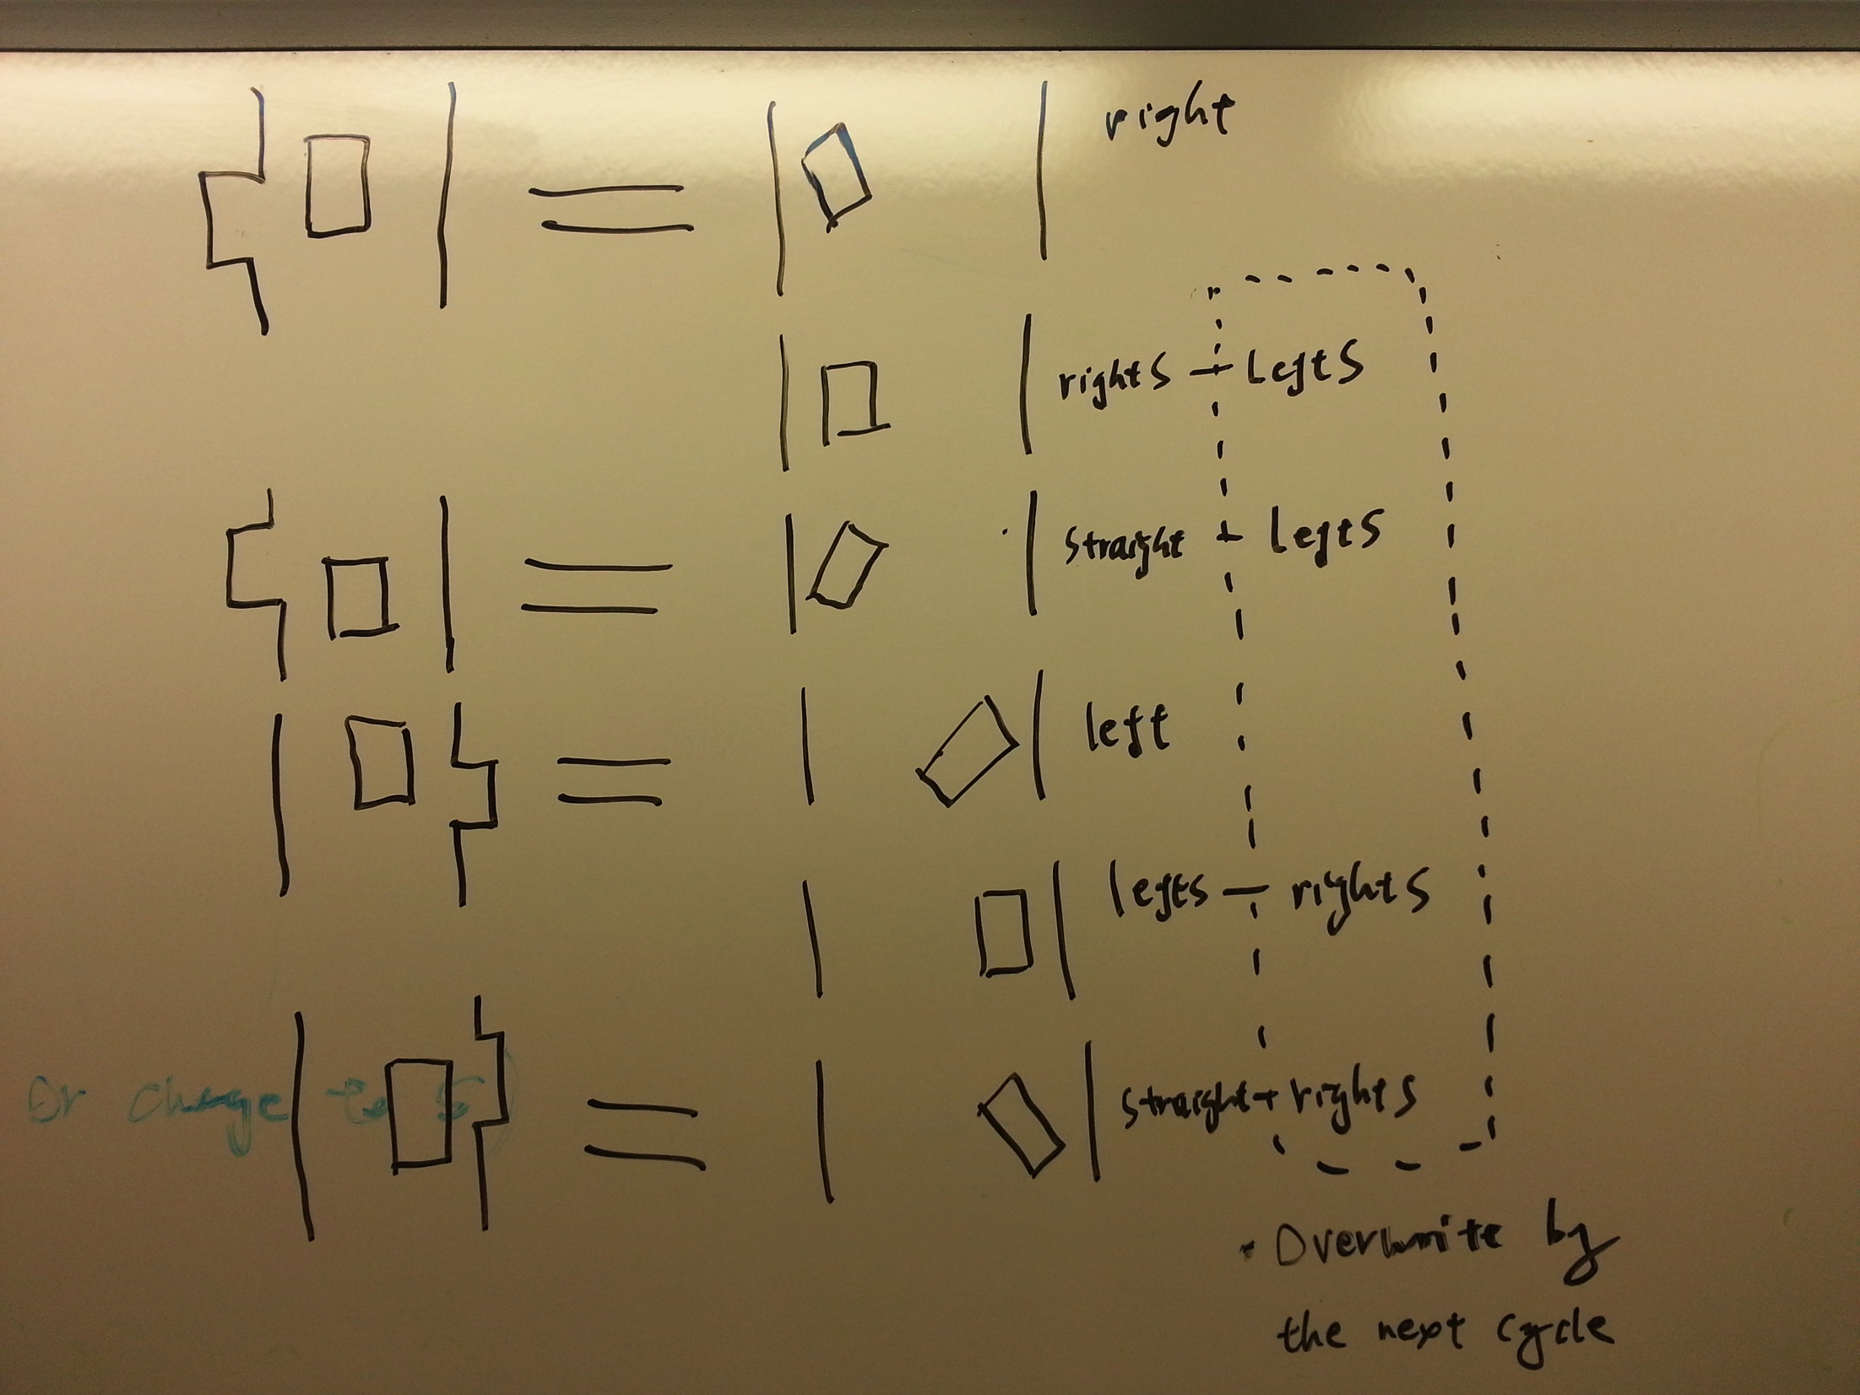
Challenges
Decision making problem for Design 2 (Wall Avoiding Strategy)

